Slide 1

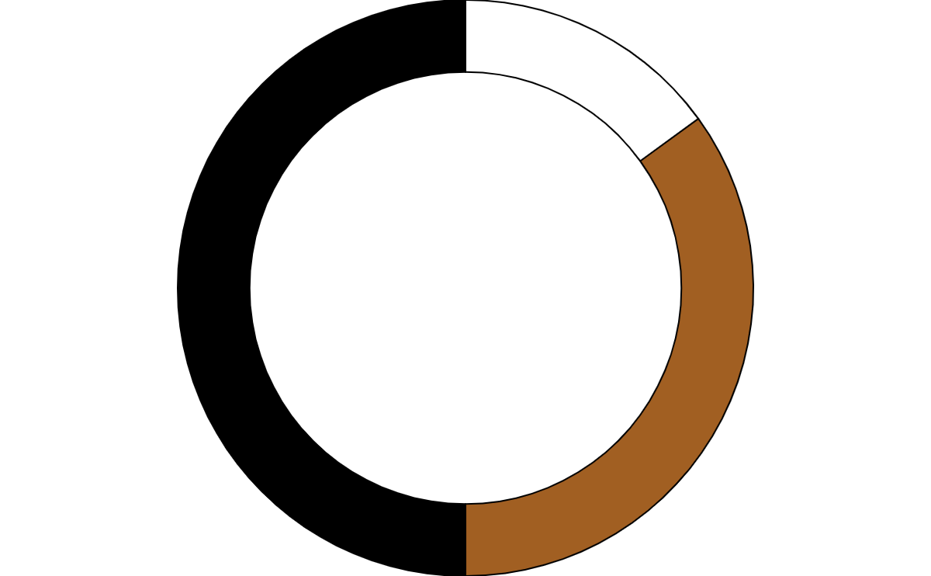

DS & ML -2504 |  | 14/08/25
Customer’s Behavior Analysis
PRESENTED BY Mir Shahadut Hossain

Slide 2
Problem Statement "In a digital marketplace flooded with choices, why do some customers convert while others abandon their carts? This analysis seeks to uncover the invisible triggers behind user clicks, scrolls, and exits—to predict intent, personalize experiences, and unlock hidden revenue potential."

Slide 3
PREVIOUS |  | NEXT
Hypothesis This project explores key hypothesis about customer behavior in an eCommerce setting. We hypothesize that faster delivery times lead to higher review scores, and discounts increase customer satisfaction. Customers who spend more time on the website are expected to make higher purchases, while return customers may prefer specific payment methods. We also suggest that device type impacts purchasing behavior, age influences product preferences, and subscribed customers show higher satisfaction. These relationships will be tested using statistical and visual analysis to uncover actionable insights.

Slide 4

Customer’s Behavior Analysis

Slide 5
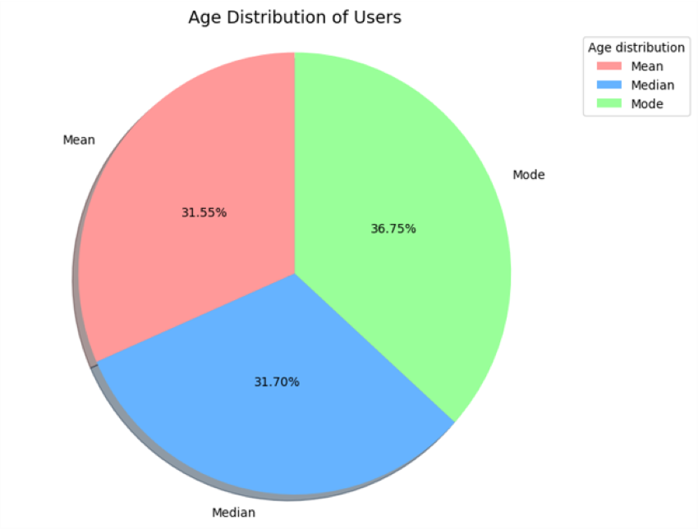
Find Mean, Median, and Mode (Age)
INSIGHT 1. Age Concentration: The mean and median are close (~44), indicating a fairly symmetric distribution around middle-aged customers. However, the mode is 51, suggesting more customers are in their early 50s than any other single age. 2. Target Segment: The data suggests your core customer base is aged 40–55, likely with: Stable income Higher brand loyalty Preference for value over trendiness 3. Low Youth Penetration: If age groups under 35 are underrepresented, you might be missing out on younger markets (millennials and Gen Z).
RECOMENDATIONS Offer curated product bundles tailored to 40–55 age group needs (health, wellness, home improvement, durable goods). Create programs that reward frequent purchases and encourage these middle-aged customers to refer family (possibly younger users). Expand to Younger Demographic (if growth needed) Launch a youth-focused sub-brand Market on Instagram/TikTok Include flexible payment options like BNPL (Buy Now, Pay Later) Targeted email and social ads: Example: "Top 5 Must-Have Home Items for 50+" Testimonials from people aged 40–60 Use platforms like Facebook and YouTube, which are more popular among this group

Slide 6
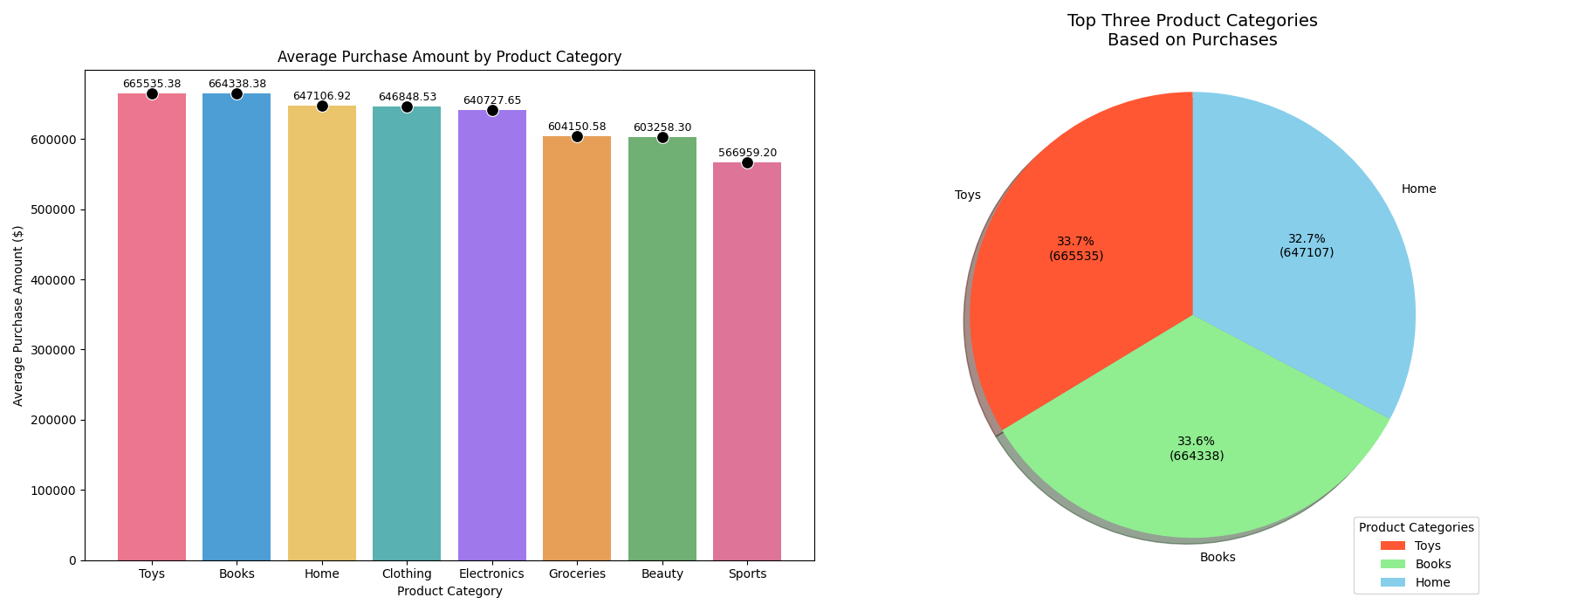
What are the top three product categories based on the number of purchases?
KEY INSIGHT Toys and Books are nearly tied in revenue, suggesting high demand and similar market size for both categories. Home products also show strong performance, likely indicating stable consumer interest in household items. Other categories like Electronics, Clothing, Groceries, Beauty, and Sports are performing below these three, either due to lower margins, limited demand, or more competition.
RECOMENDATIONS Double Down on Toys & Books Promotions & Bundling: Offer bundle deals (e.g., books + educational toys) to increase cart size. Seasonal Targeting: Boost marketing around holidays and school terms when toy/book sales spike. Enhance Home Product Offerings Focus on value-added home goods like multipurpose furniture, decor, and smart home gadgets. Explore subscription models (e.g., monthly home essentials) to increase repeat purchases. Improve Underperforming Categories Investigate why categories like Clothing or Beauty aren't top performers—check pricing, product quality, or marketing visibility. Consider A/B testing new designs, influencer marketing, or flash sales to revive these categories.

Slide 7
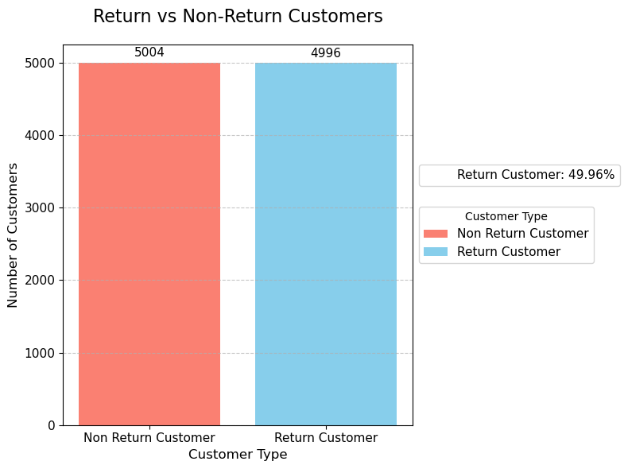
How many customers are classified as return customers?
INSIGHT The customer base is almost evenly split: ~50% are return customers ~50% are one-time buyers Half of your customers do not return after their first purchase — indicating a missed opportunity in customer retention. While a 50% return rate is decent in some industries, it could likely be improved with better post-purchase engagement and loyalty incentives.
RECOMMENDATIONS 1. Implement a Loyalty Program Offer points, discounts, or exclusive products for repeat purchases Example: “Buy 2, Get 1 Free” for returning customers 2. Follow-Up Email Campaigns Send personalized emails after the first purchase: Product usage tips Cross-sell suggestions Discount code for 2nd order (e.g., “10% off your next order”) 3. Track and Target One-Time Buyers Segment and retarget the 5004 non-return customers Offer incentives like: Free shipping on 2nd order Time-limited deal (e.g., “Come back within 7 days for 20% off”) 4. Enhance Post-Purchase Experience Improve: Delivery speed Packaging Customer service

Slide 8
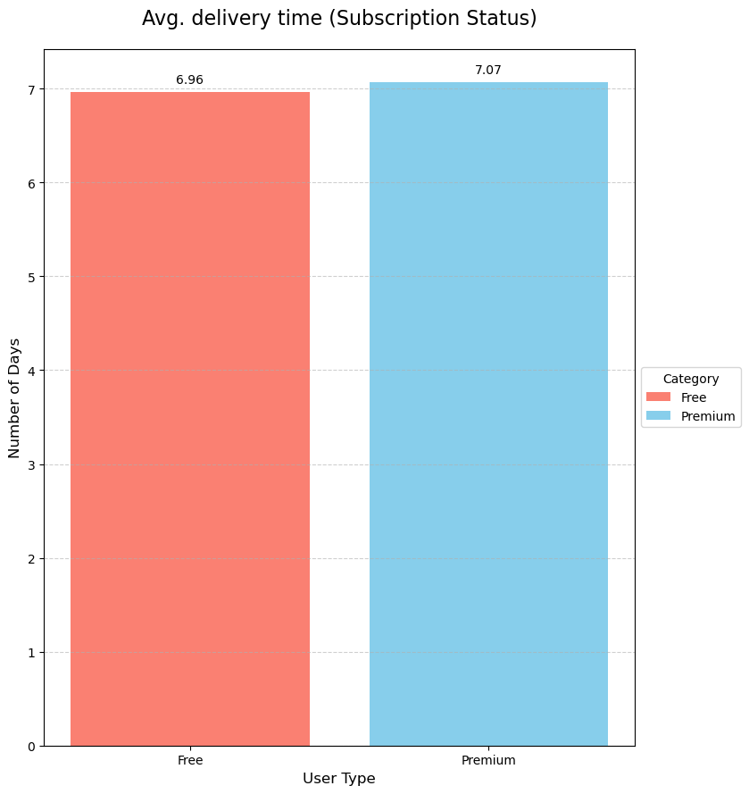
How does the average delivery time vary between subscription statuses (Free, Premium)?
INSIGHT Surprisingly, Premium subscribers experience slightly slower delivery than Free users — 7.07 vs. 6.96 days. This result is counterintuitive, since Premium users generally expect faster or priority shipping in exchange for their subscription fee. Implications This may create frustration or dissatisfaction among Premium users. t risks undermining the perceived value of the Premium service. Could lead to higher churn or lower upgrade rates.
BUSINESS RECOMENDATIONS 1. Audit Fulfillment for Premium Users Investigate why Premium deliveries are slower: Are they receiving items from different warehouses? Are there more out-of-stock or specialty items? 2. Prioritize Shipping for Premium Orders Tag Premium orders in the logistics system Ensure faster carriers or faster fulfillment windows 3. Set and Communicate Clear Expectations If Premium includes benefits other than faster shipping (e.g., exclusive products, extended return), make that clear in marketing Or, if faster delivery is promised, adjust operations to meet it 4. Offer Partial Refunds or Perks for Delays For Premium members experiencing slow delivery, offer: Credit Free month of Premium Apology email with a discount

Slide 9
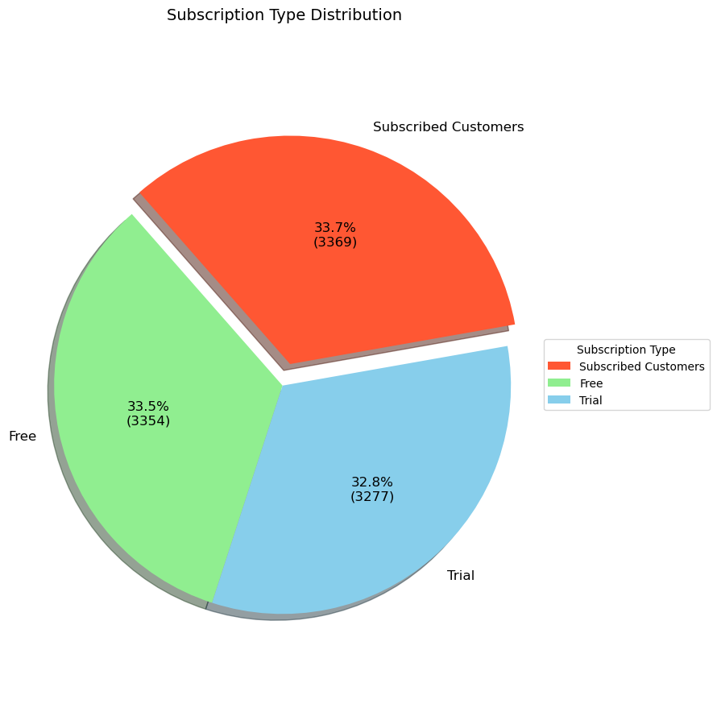
How many customers are subscribed to the service?
INSIGHT Only 33.69% of users are paying subscribers (Premium), while 66.31% are non-paying (Free or on Trial). The user base is evenly split, but a large portion (65%+) aren’t paying, which is a huge opportunity for conversion. You're potentially leaving revenue on the table if Trial/Free users don’t convert to Premium.
BUSINESS RECOMMENDATIONS 1. Optimize Trial-to-Premium Conversion Funnel Offer timed discounts near the end of the trial: “Upgrade in the next 3 days and get 20% off for 3 months” Show Premium benefits clearly with side-by-side feature comparison 2. Incentivize Upgrades for Free Users Give limited-time premium access (e.g., 7-day Premium demo) “Join 3,369 other Premium users and get faster delivery + exclusive perks” 3. Engage Trial Users with Onboarding Emails Email Series: Day 1, 3, 7, 13 Highlight top features Testimonials from Premium users Auto-renew reminder with upgrade CTA 4. A/B Test Premium Pricing or Feature Bundles Test different price points or "lite" premium tiers to convert more Trial users 5. Track Trial Churn Measure how many Trial users downgrade or leave Collect feedback: “What stopped them from upgrading?”

Slide 10
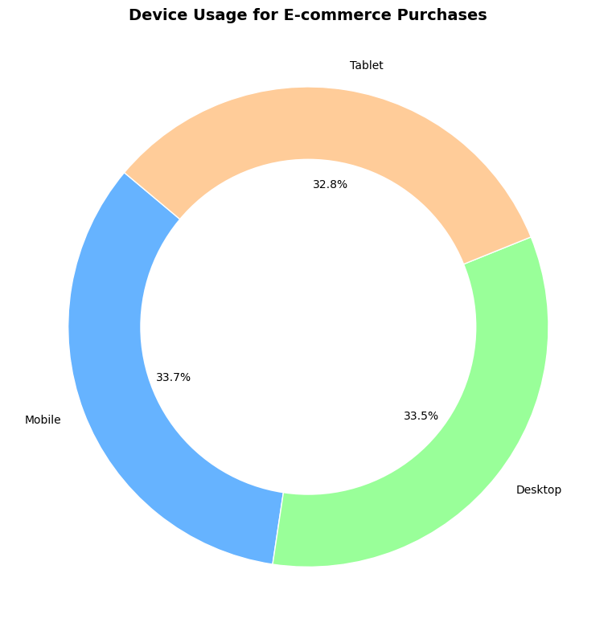
What percentage of customers used devices to make purchases? (Mobile, Desktop, Tablet)
KEY INSIGHT Customer purchases are evenly distributed across Mobile, Desktop, and Tablet devices, with Mobile leading slightly. This suggests a multi-device customer base, meaning your shopping experience must be optimized across all platforms.
BUSINESS RECOMMENDATIONS 1. Optimize for All Devices (Omnichannel UX) Ensure a responsive design for your website/app Make sure key features (checkout, cart, product search) work seamlessly on mobile, tablet, and desktop 2. Invest in Mobile-First Enhancements Since Mobile leads slightly, prioritize: Fast load times Simplified mobile navigation Mobile wallet integration (e.g., Apple Pay, Google Pay) 3. Track Behavior by Device Analyze: Conversion rate by device Bounce rate and session time Cart abandonment rate Improve the device with the lowest conversion performance 4. Personalize Marketing by Device Send mobile-friendly emails with deep links for mobile users Target tablet/desktop users during evenings or weekends

Slide 11
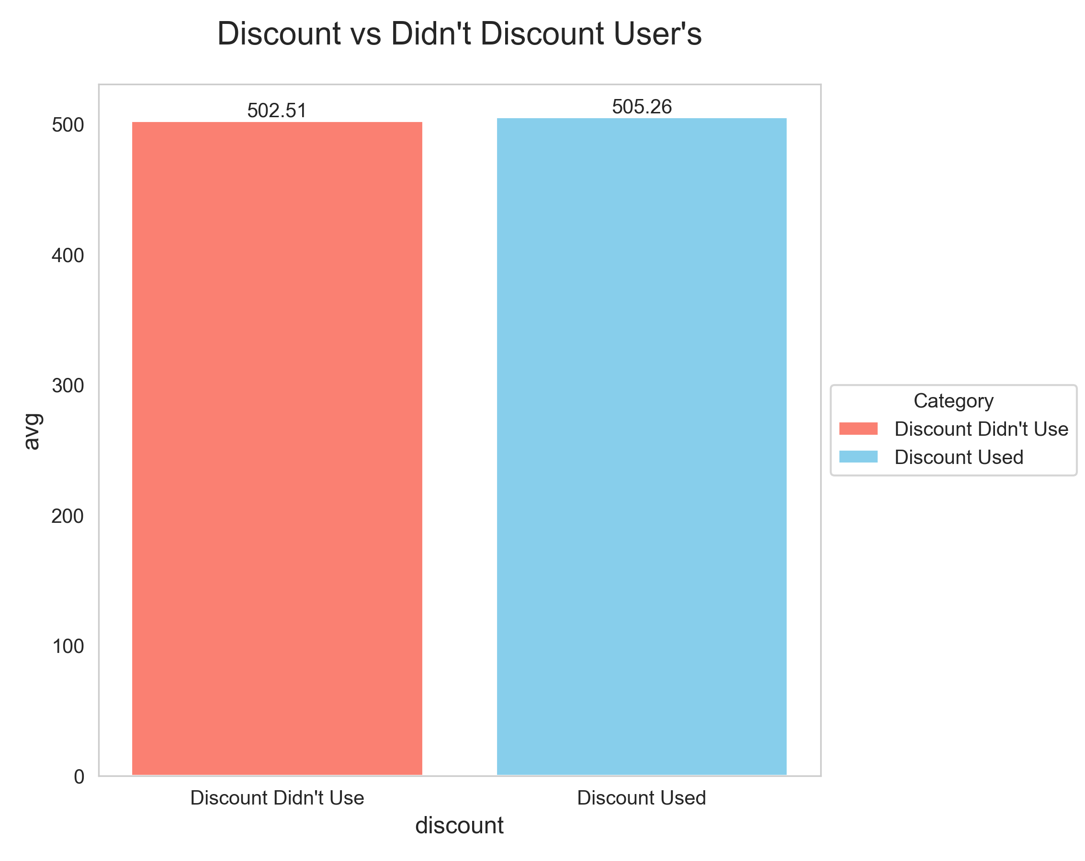
What is the average purchase amount for customers who availed discounts compared to those who didnʼt?
KEY INSIGHT Surprisingly, customers who used discounts spent slightly more on average than those who didn't — $505.26 vs. $502.51. The difference is small (~$2.75), but it defies the common expectation that discounts reduce purchase amounts. This suggests that discounts may actually encourage larger purchases, possibly due to: Customers buying more items to "maximize the deal“ Customers choosing higher-priced products when a discount is available
BUSINESS RECOMMENDATIONS 1. Use Strategic Discount Triggers Offer small discounts (e.g., 5–10%) to increase basket size Example: “Get 10% off orders over $500” 2. Launch Threshold-Based Discounts Encourage higher spend by setting minimums: “Spend $450 and get $25 off” 3. Track ROI of Discount Campaigns If discounts lead to higher overall revenue per user, they are worth expanding Track AOV (Average Order Value) and LTV (Lifetime Value) of discount users vs. non-discount users 4. Time-Limited or Product-Specific Discounts Offer targeted discounts on specific categories or slow-moving items to boost both sales and AOV 5. Upsell with Discount Anchors Example: “Customers who used this 5% coupon also bought...” Combine discounts with cross-sell bundles

Slide 12
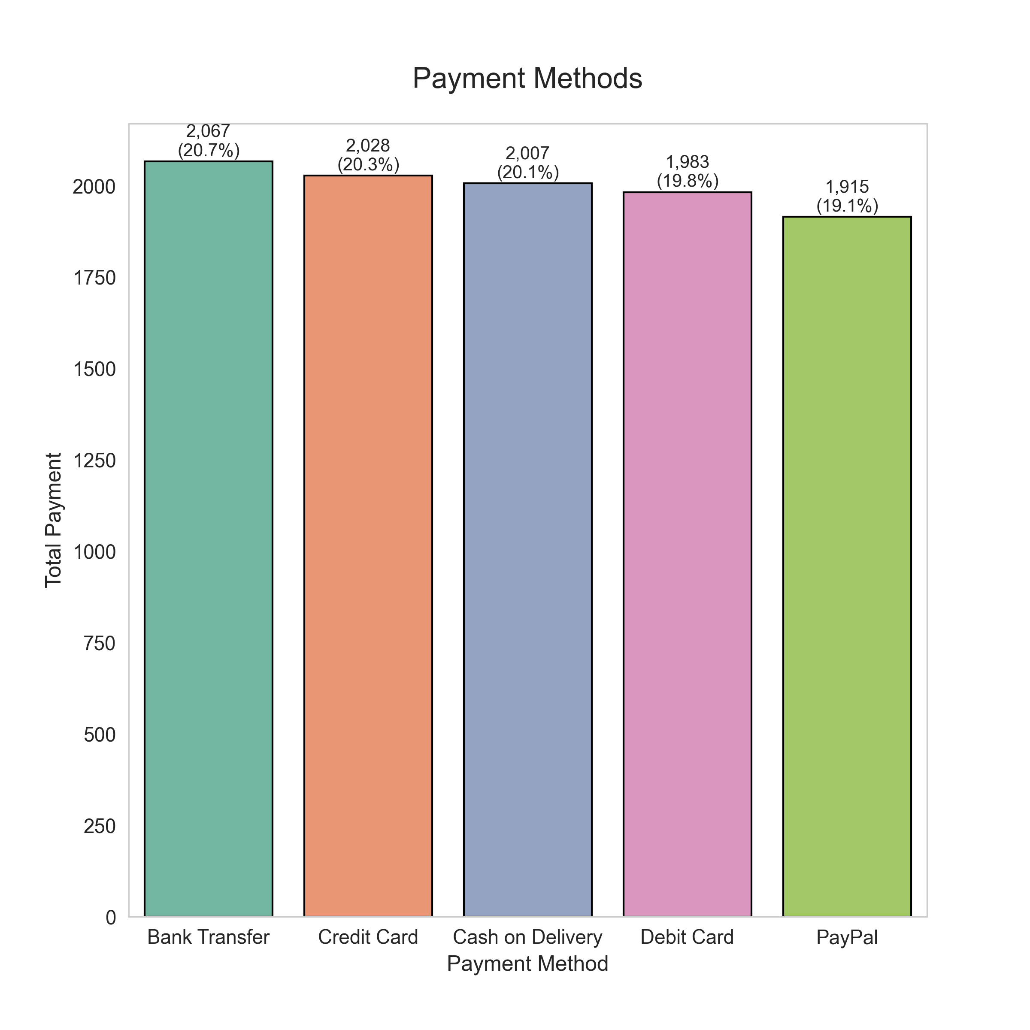
What is the most common payment method used by customers?
KEY INSIGHT Customer preferences are evenly distributed across all payment methods, with no single method overwhelmingly dominant. Despite minor differences in numbers, each of the five methods—Bank Transfer, Credit Card, Cash on Delivery, Debit Card, and PayPal—accounts for roughly 19–21% of total transactions: Bank Transfer (20.67%) is the most used, but only marginally ahead of others. Credit Card (20.28%) and Cash on Delivery (20.07%) follow closely, showing their continued popularity. Debit Card (19.83%) and PayPal (19.15%) also maintain strong user bases.
BUSINESS RECOMENDATIONS High Payment Diversity Your customer base is not skewed toward one particular payment method. People are comfortable using a variety of payment options, which may reflect: Different demographics (e.g., older users preferring bank transfer) Varying levels of trust or convenience Device and region-related access to certain payment methods User Flexibility and Expectations Customers expect to choose their preferred method at checkout. Removing or deprioritizing any one method could negatively affect a sizable portion of users (~20%). System Reliability Must Be Broad Since no one method accounts for even a quarter of your user base, you cannot afford a failure in any of them. Equal attention must be given to maintaining reliability, security, and speed across all options.

Slide 13
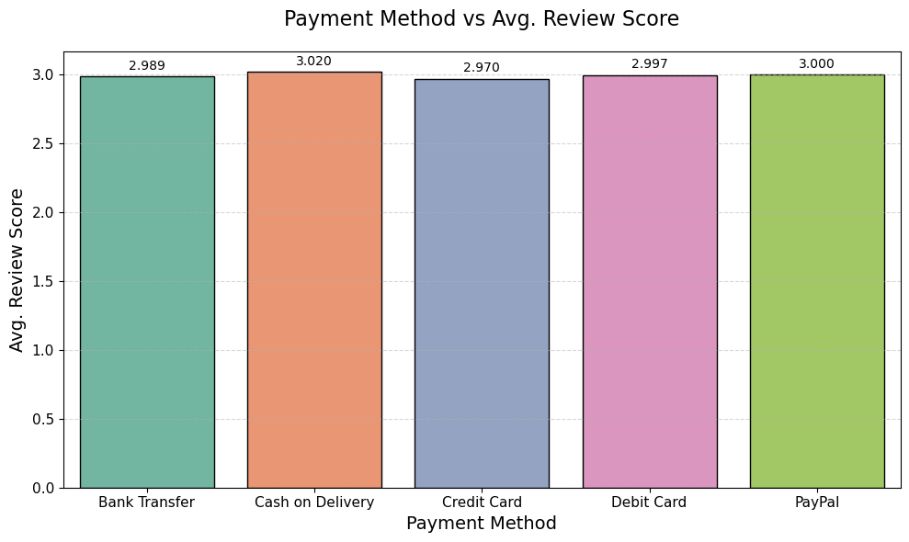
What are the average review scores of users of the most common payment method?
KEY INSIGHT The most common payment method (assuming frequency, though all are shown) likely has average review scores around 3.0 — none of the payment methods exceed a 3.02 average, which is moderate on a 1–5 scale. Highest satisfaction: Cash on Delivery (3.02) Lowest satisfaction: Credit Card (2.97) The difference is small, but Cash on Delivery users report slightly higher satisfaction, which could suggest trust and convenience play a role in user sentiment.
BUSINESS RECOMENDATONS Promote Cash on Delivery in Low-Trust Markets: Leverage the slightly higher satisfaction rating by promoting Cash on Delivery in regions or segments where trust in online payment is low. Improve Online Payment Experience: Since digital methods like Credit Card and Debit Card score slightly lower, ensure payment gateways are secure, error-free, and easy to use to prevent frustration. Gather Feedback on Payment Process Pain Points: Survey users post-purchase to identify if dissatisfaction stems from payment errors, delays, or refund issues — especially for card and PayPal users. Offer Incentives to Encourage Digital Payment Adoption: If promoting digital payments is a goal, pair them with exclusive discounts or cashback offers to offset any hesitation or dissatisfaction.

Slide 14
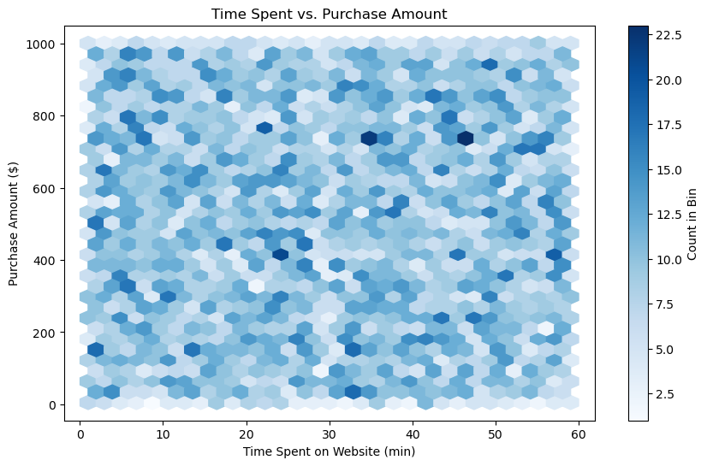
What is the correlation between time spent on the website and purchase amount?
KEY INSIGHT There is almost no linear relationship between the time customers spend on the website and how much they purchase. The correlation between Time Spent on Website and Purchase Amount is +0.01, which is extremely weak and almost negligible. This means: Customers who spend more time on the website are not significantly more likely to spend more money.
BUSINESS RECOMENDATIONS Improve Conversion Efficiency: Since more time doesn’t translate to higher spending, focus on making the buying process faster and more intuitive, reducing unnecessary browsing friction. Optimize Product Discovery: Use personalized recommendations and smarter search filters to help users find what they need quickly — improving both satisfaction and conversion. A/B Test Time-Based Promotions: Try limited-time offers or exit-intent popups to convert hesitant users who linger on pages too long without buying. Refocus Analytics on Better Predictors: Time spent isn't a strong predictor of revenue. Prioritize metrics like cart additions, click-through rate, or repeat visit frequency for decision-making.

Slide 15
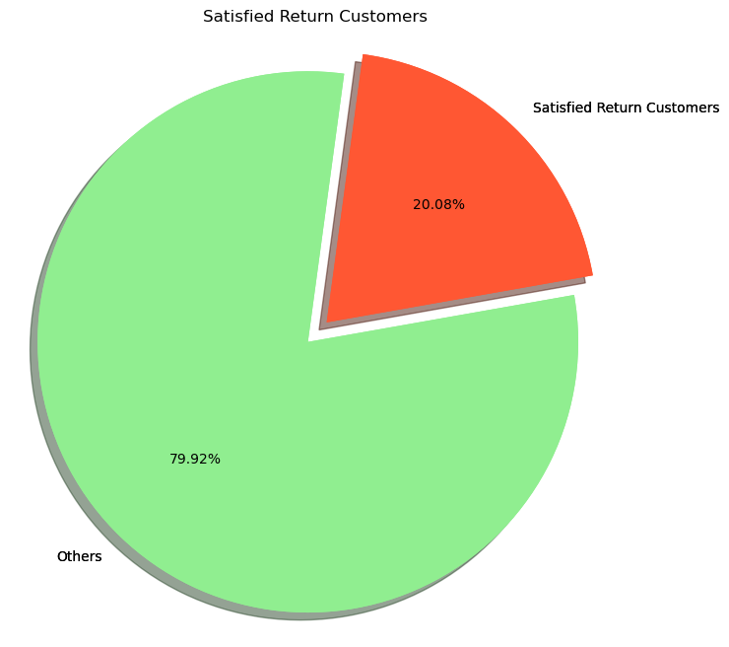
What percentage of customers are satisfied (rating of 4 or 5) and are also return customers?
KEY INSIGHT Only 20.08% of customers are satisfied return customers — meaning just 1 in 5 customers who return to shop are highly satisfied (review score ≥ 4). This highlights a critical retention gap: most returning customers are not experiencing a consistently satisfying experience, which threatens long-term loyalty and revenue.
BUSINESS RECOMENDATION Enhance the Post-Purchase Journey: Improve delivery reliability customer support return/exchange policies To ensure returning customers feel valued and supported. Launch a Return Customer Loyalty Program: Introduce incentives (points, exclusive offers) for repeat buyers to boost satisfaction and encourage positive reviews. Gather Feedback from Unsatisfied Return Customers: Use follow-up surveys or feedback forms to understand why returning customers are not satisfied, and address pain points directly. Personalize the Experience for Returnees: Tailor product recommendations emails, and offers based on past purchases To increase engagement and perceived value.

Slide 16
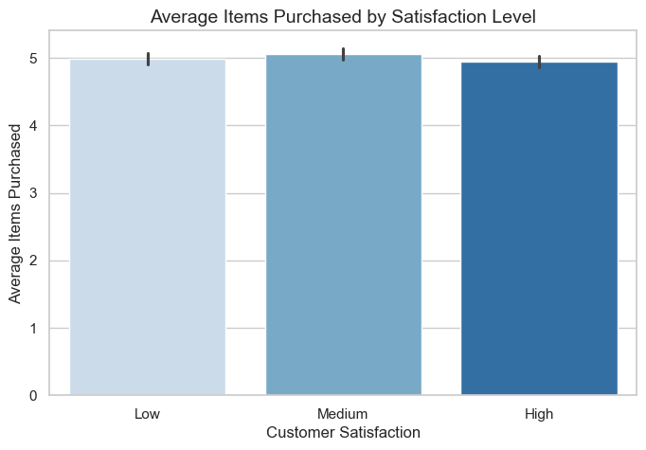
What is the relationship between the number of items purchased and customer satisfaction?
KEY INSIGHT Virtually No Linear Relationship Customers who buy more items are not necessarily more or less satisfied. Similarly, customers who are more satisfied don’t tend to buy more (or fewer) items. In short: these two variables are likely independent of each other in your dataset.
BUSINESS RECOMENDATION Focus on Experience, Not Just Quantity: Since buying more items doesn't impact satisfaction, Put prioritize on this: quality of service, ease of navigation post-purchase support to improve customer satisfaction. Enhance Value Per Transaction: Instead of pushing for more items per order, optimize individual product value and experience . Such as through premium packaging surprise gifts loyalty points. Dig Deeper into Drivers of Satisfaction: Run surveys or sentiment analysis to uncover true satisfaction drivers. Such as delivery time Support and return policy allocate improvement efforts accordingly. Avoid Over-Reliance on Upselling: Since it doesn’t increase satisfaction, aggressive upselling could backfire. Focus on relevance and personalization instead of volume.

Slide 17
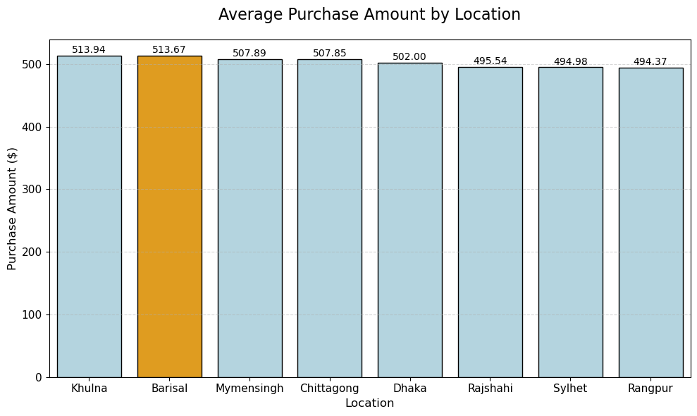
Which location has the 2nd highest average purchase amount?
KEY INSIGHT Khulna ($513.94) and Barisal ($513.67) have the highest average purchase amounts, closely followed by Mymensingh and Chittagong. Rangpur ($494.37) and Sylhet ($494.98) show the lowest average purchase amounts among the listed cities. The difference between the highest and lowest locations is about $20, which is relatively moderate but still meaningful at scale.
BUSINESS RECOMENDATION Focus Marketing Campaigns on High-Potential Locations (Khulna & Barisal): Recommendation: Increase ad spend, promote premium products, or test bundled offers in Khulna and Barisal to capitalize on customers’ willingness to spend. Investigate Low-Spending Regions (Rangpur & Sylhet): Recomendation: Run A/B tests with tailored discounts, localized promotions, or free delivery offers to uplift spending. Adopt Geo-Targeted Strategies: Tailor offerings, pricing, and ads based on regional spending patterns to enhance personalization and conversion efficiency. Operational Optimization: Since higher-spending regions might also correlate with higher order volumes, ensure inventory and logistics in Khulna and Barisal are optimized for demand Customer Segmentation: Segment customers by location and purchase amount to build better predictive models for future sales, retention, and lifetime value. Strengthen Supply Chain in Key Areas: Ensure robust inventory and fulfillment capabilities in high-performing zones to support sustained demand and customer satisfaction.

Slide 18
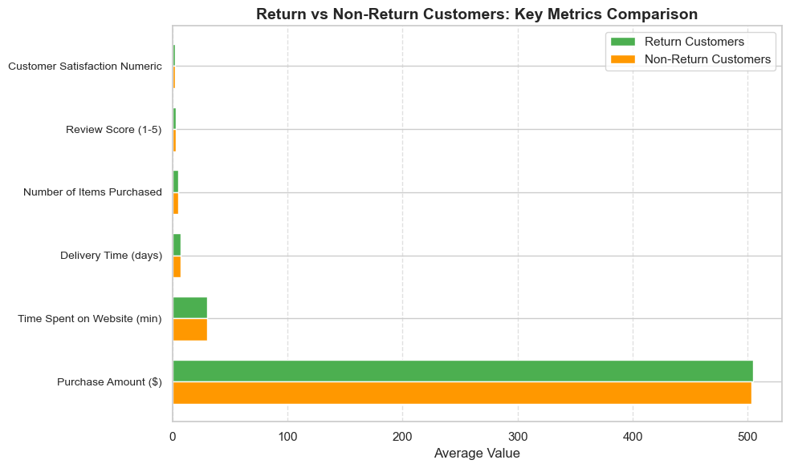
What factors contribute most to a customer being classified as a return customer?
KEY INSIGHT Highest Satisfaction: Bank Transfer Customers who paid via Bank Transfer report the highest satisfaction (2.01). This might reflect trust, security, or clarity in transactions via bank systems. Cards Perform Well Credit and Debit Cards show nearly equal satisfaction (~2.00), slightly below Bank Transfer. These are commonly used and perhaps offer more predictable experiences. Cash on Delivery is Least Satisfying Customers using Cash on Delivery (COD) report the lowest satisfaction (1.96). Potential reasons: Longer delivery time Manual payment hassle Less confidence in post-payment service PayPal Slightly Underperforms Surprisingly, PayPal ranks below cards, suggesting: Possible technical/integration issues User trust or refund concerns International vs local user experience mismatch STRATEGIC TAKEAWAYS Consider promoting bank transfer and card payments with smoother checkout experiences and incentive Investigate why Cash on Delivery yields lower satisfaction: Are delays, refund issues, or verification steps causing friction? If PayPal is popular, explore if UX or localization can be improved. Educate users on secure payment methods and offer support post-purchase to boost satisfaction.
RECOMENDATION Encourage credit card and bank transfer usage by offering: Discount codes Cashback Loyalty points Reduce friction for COD customers by: Offering account creation after first order Promoting wallet/prepaid options for reorders Monitor if return rate correlates with other satisfaction factors (e.g., delivery time, support experience)

Slide 19
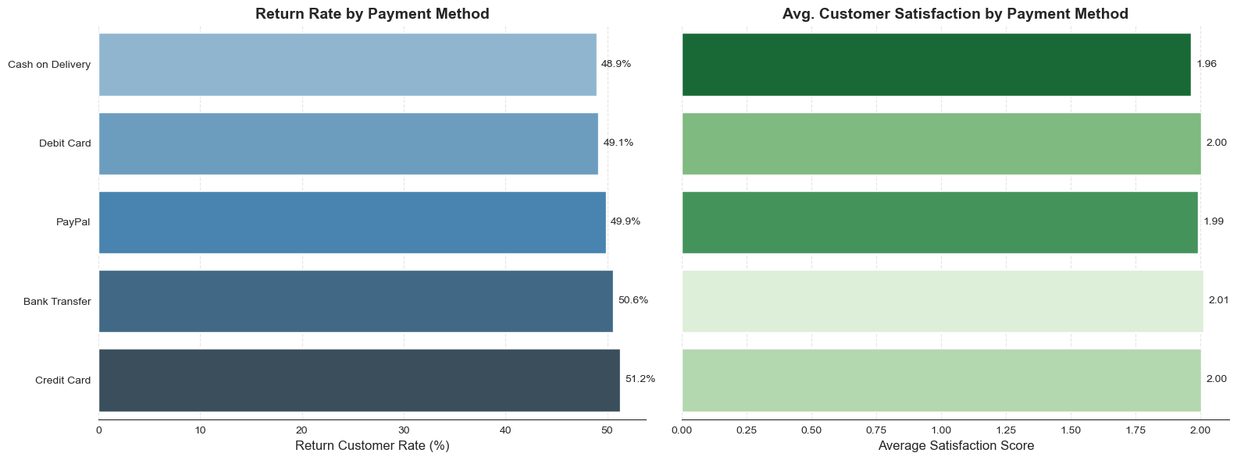
How do payment methods influence customer satisfaction and return rates?
KEY INSIGHT Bank Transfer users report the highest average customer satisfaction (2.01), followed closely by Credit Card and Debit Card users. Cash on Delivery customers have the lowest satisfaction (1.96). INTERPRETATION Bank Transfer 2.01 (just above Medium) Customers using bank transfers are slightly more satisfied on average. This might indicate that this group finds the payment process reliable and convenient, or possibly these are higher-value customers receiving better service. Credit Card 2.00 (Medium) Credit card users are also quite satisfied, aligning with their higher return rate from before. This suggests a positive overall experience. Debit Card 2.00 (Medium) Similar satisfaction to credit card users, reflecting ease of use and reliability. PayPal 1.99 (just below Medium) Slightly lower satisfaction, which may reflect issues like transaction fees, account restrictions, or customer service. Cash on Delivery 1.96 (closer to Low/Medium) Lowest satisfaction. This could be due to the inconvenience of waiting for delivery before payment, issues with product receipt, or lack of trust and convenience in the payment process.
BUSINESS RECOMENDATION Focus on improving satisfaction for Cash on Delivery customers, who have the lowest satisfaction and return rates. Enhancing delivery experience, communication, or offering alternative payment incentives could help. Bank Transfer users are very satisfied — understanding what drives their satisfaction could help improve other segments. The close satisfaction scores for Credit and Debit Card users align with their higher loyalty—maintain and reward these customers. Consider reviewing PayPal user experience to identify potential pain points. Summary Payment method not only correlates with customer return rates but also with satisfaction. Digital and direct bank payments tend to have higher satisfaction, while Cash on Delivery users lag behind. This insight can guide targeted improvements in payment options and customer experience strategies.

Slide 20
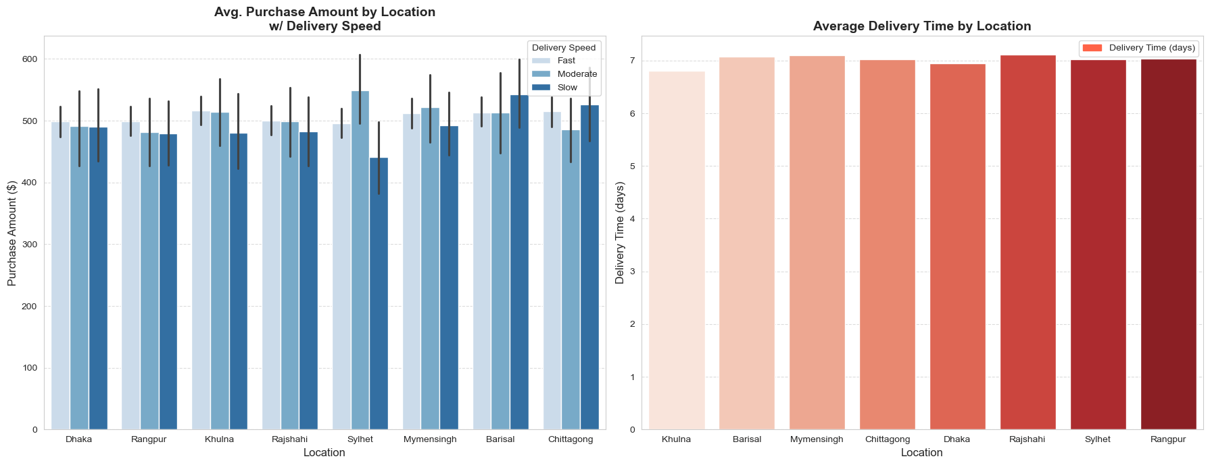
How does the location influence both purchase amount and delivery time?
KEY INSIGHT Khulna stands out with the highest average purchase amount and fastest delivery, suggesting a strong market presence and efficient supply chain. Locations like Rajshahi, Sylhet, and Rangpur have the lowest purchase amounts and slower deliveries, indicating potential challenges in customer demand or logistics. Delivery times are relatively consistent across locations (around 6.8 to 7.1 days), but even small differences could impact customer satisfaction. Dhaka, despite being a major city, shows slightly lower purchase amounts, possibly due to market saturation or higher competition.
Business Recommendations: Focus on improving delivery times in Rajshahi, Sylhet, and Rangpur to boost customer satisfaction and possibly increase purchase amounts. Investigate what makes Khulna efficient in both sales and delivery to replicate best practices in other regions. Explore marketing or promotional campaigns in lower-performing regions to increase customer purchase amounts. Monitor delivery logistics to maintain or improve delivery times, especially in major hubs like Dhaka.

Slide 21
MAJOR INSIGHTS
Customer Satisfaction is Highly Influenced by Delivery Time Customers who received their products more quickly consistently gave higher review scores. As delivery time increases, customer satisfaction drops noticeably, indicating that efficient logistics are key to improving overall customer experience. This trend emphasizes the need to optimize the supply chain and ensure timely delivery, especially for first-time buyers who are more sensitive to delays. Returning Customers Show Stronger Loyalty and Higher Satisfaction The data reveals that returning customers tend to provide higher review scores and report greater satisfaction with their purchases. They are also more likely to purchase more items and engage in higher spending. This suggests that customers who had positive prior experiences are more trusting and loyal, making them a valuable segment to retain through loyalty programs, personalized offers, or exclusive deals. Top Revenue-Generating Product Categories Toys, Books, Home Essentials these categories together account for a significant portion of total sales, making them prime candidates for promotion, bundling, or upselling strategies. Increasing inventory or visibility of these products can lead to higher returns, especially during peak seasons. Payment Method Usage vs. Satisfaction While Bank Transfer is the most commonly used payment method, it doesn't score highest in terms of customer satisfaction. In contrast, Cash on Delivery users reported slightly better satisfaction, even though it is used less frequently. This suggests that payment flexibility can impact customer trust and perception. Introducing or promoting secure and convenient payment options (like mobile wallets or EMI options) might enhance the user experience further. Location-Wise Purchase Behavior and Spending Purchase trends vary greatly across locations. Customers in Dhaka, Chittagong, and Khulna show higher spending patterns. Urban areas tend to have shorter delivery times and higher review scores. This geographic variation highlights the need for region-specific marketing strategies and logistics optimization to better serve high-value zones and improve services in lower-performing areas. Subscription Status Drives Higher Spending and Satisfaction Customers with an active subscription status tend to spend more per purchase, purchase more frequently, give higher review scores. This indicates that subscription programs are effective in boosting customer engagement and loyalty. Expanding such programs or offering tiered benefits can enhance revenue while maintaining high satisfaction levels. Device Type and Gender Influence Shopping Behavior Preliminary patterns suggest, mobile users may spend less time on the website but still complete purchases efficiently. Gender shows potential variation in preferred product categories and spending habits. Although the impact is less significant than other variables, these insights can be used to tailor user experiences, such as optimizing mobile UX or designing gender-targeted promotions. Discount Availment Positively Impacts Purchase Volume Customers who availed discounts tend to: purchase more items, show slightly higher satisfaction, be more likely to return for future purchases. This suggests that discounts not only help increase sales volume but also encourage positive customer perception and repeat behavior. Strategic use of discounts—especially time-limited or personalized ones—can drive both short-term sales and long-term loyalty.

Slide 22

Conclusion This analysis highlights how various factors—such as delivery time, discounts, device type, and customer demographics—influence customer satisfaction and purchasing behavior. The findings can help businesses tailor their strategies to improve service quality, enhance user experience, and boost customer loyalty.

